Slide 1
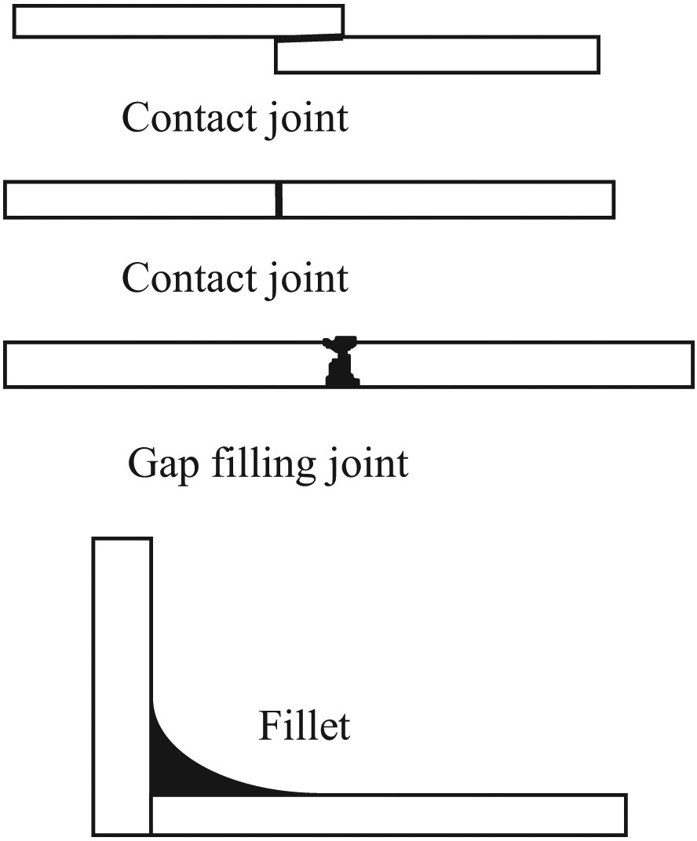
Copyright © 2016 Elsevier Ltd. All rights reserved.

Slide 2
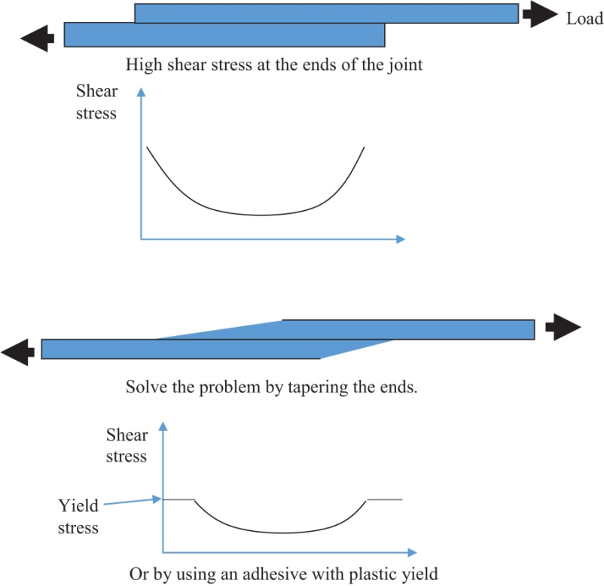
Copyright © 2016 Elsevier Ltd. All rights reserved.

Slide 3
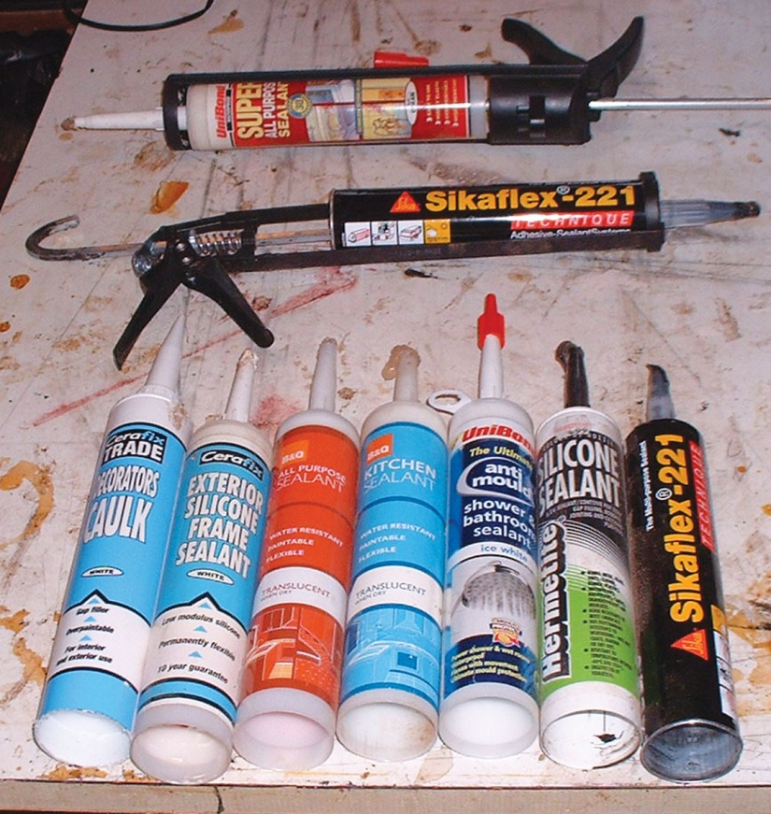
Copyright © 2016 Elsevier Ltd. All rights reserved.

Slide 4
FIGURE 39.1 Typical Joint Arrangements for Rigid Adhesives
Copyright © 2016 Elsevier Ltd. All rights reserved.

